Slide 1



VOIS Innovation
Marathon 2.0

Slide 2
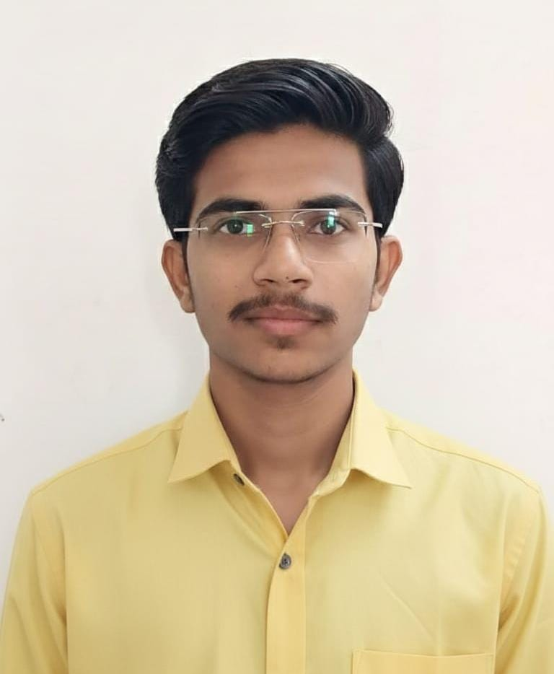

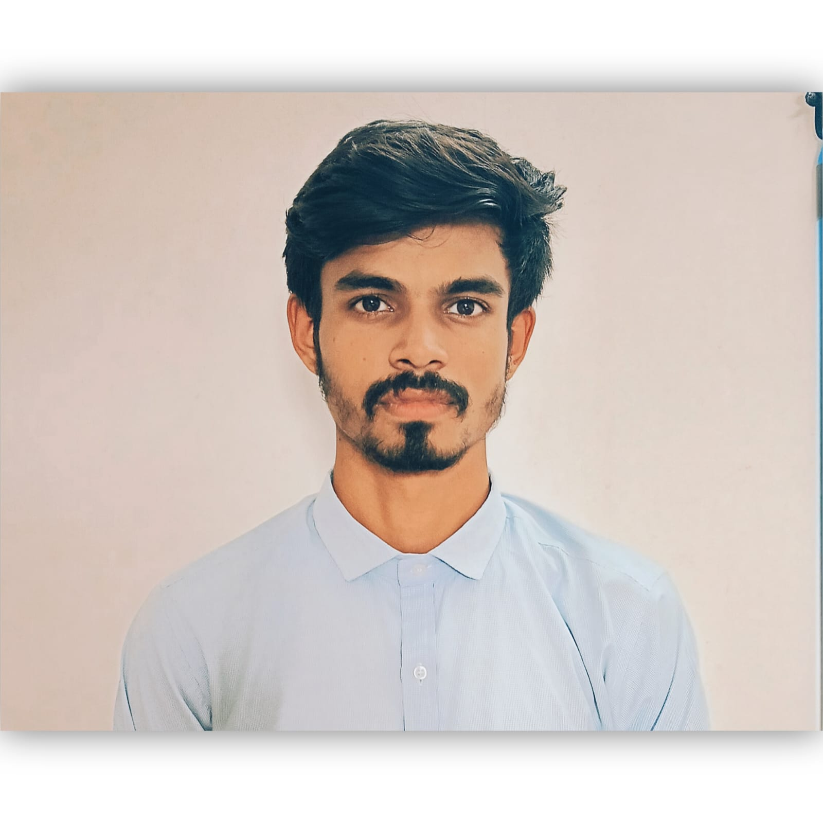
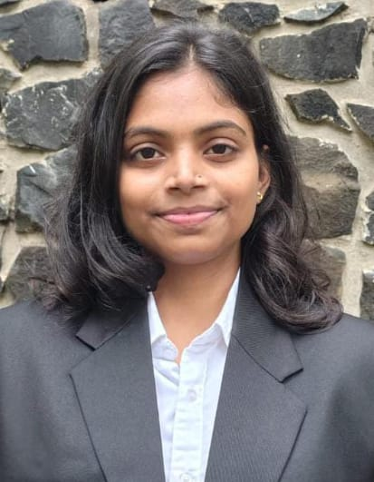

Project Title : “ WARVIDS: Wireless Autonomous Rover for Vision-based Intelligent Defence System ”
Insert your professional photo
Team Lead
Lokesh Sawankar, ECE
Team No. 54
Insert your professional photo
Insert your professional photo
Insert your professional photo
College Name
Priyadarshini College of Engineering Nagpur
Dnyaneshwar Chikte, ECE
Astha Bhakare, ECE

Slide 3






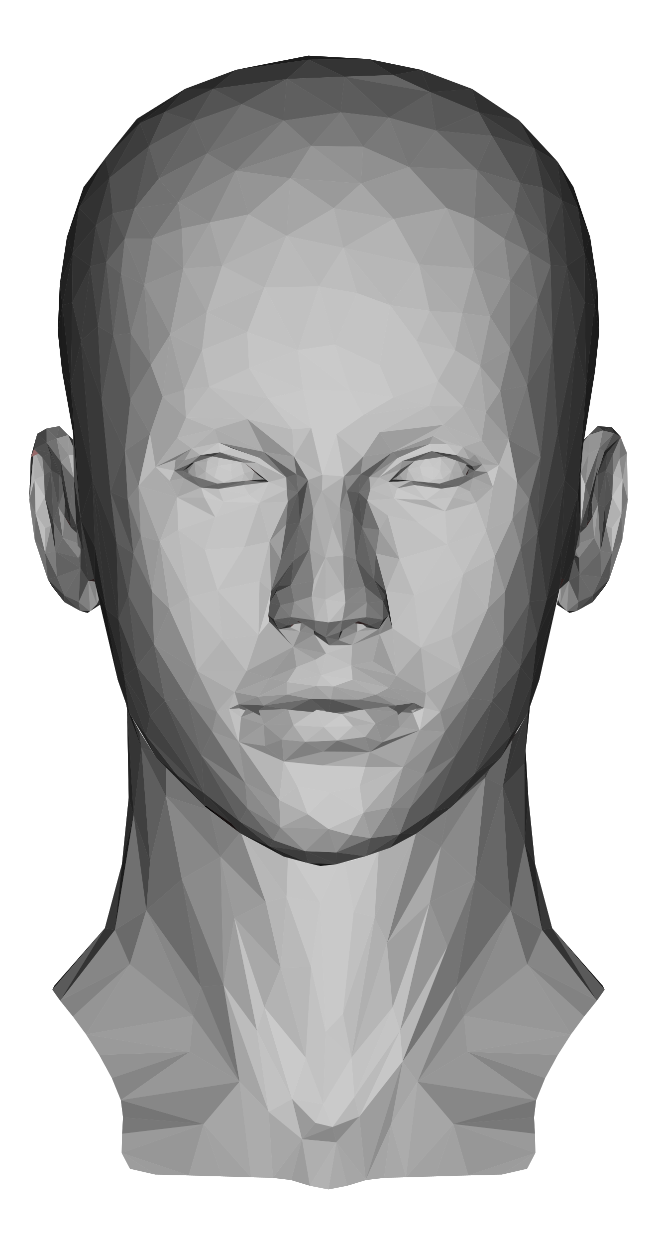

Problem Statement
The Challenge: Remote monitoring and targeting in dangerous areas face several problems:
Human Risk - Entering hazardous or combat areas is unsafe for humans..
Difficult Manual Control– Controlling camera and targeting systems manually is complex and slow.
High Operator Stress– Operators must control movement, camera, and targeting at the same time, causing errors.
Need for Natural Control– Existing systems lack intuitive control like head-movement tracking.
Therefore, a mobile rover with live video streaming and head-tracking control is required for safe and efficient remote surveillance.

Slide 4
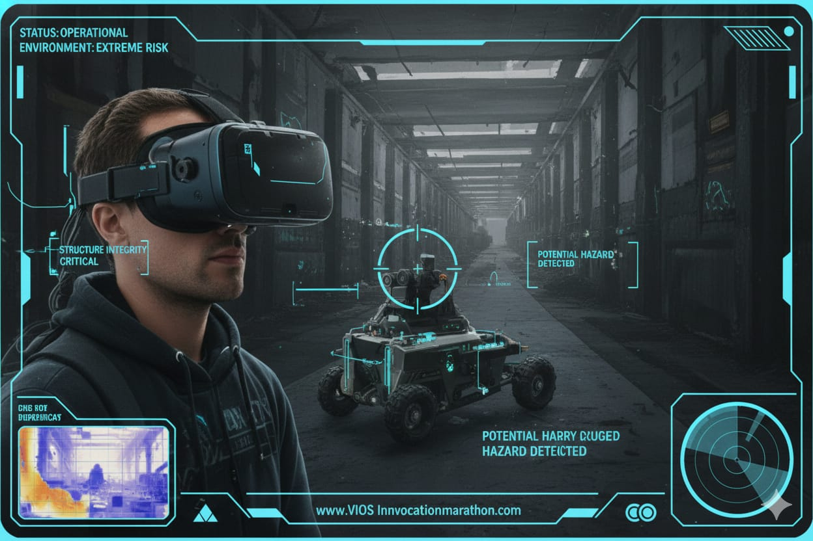
Need of Project
To enable safe monitoring in dangerous or inaccessible areas without risking human life.
To reduce operator workload and stress during remote operations.
To provide real-time video feedback for better decision-making.
To allow easy and natural control using head-tracking instead of complex manual aiming.
To improve accuracy and response time in surveillance and targeting tasks.
The project provides a safer, smarter, and more efficient remote surveillance solution.

Slide 5
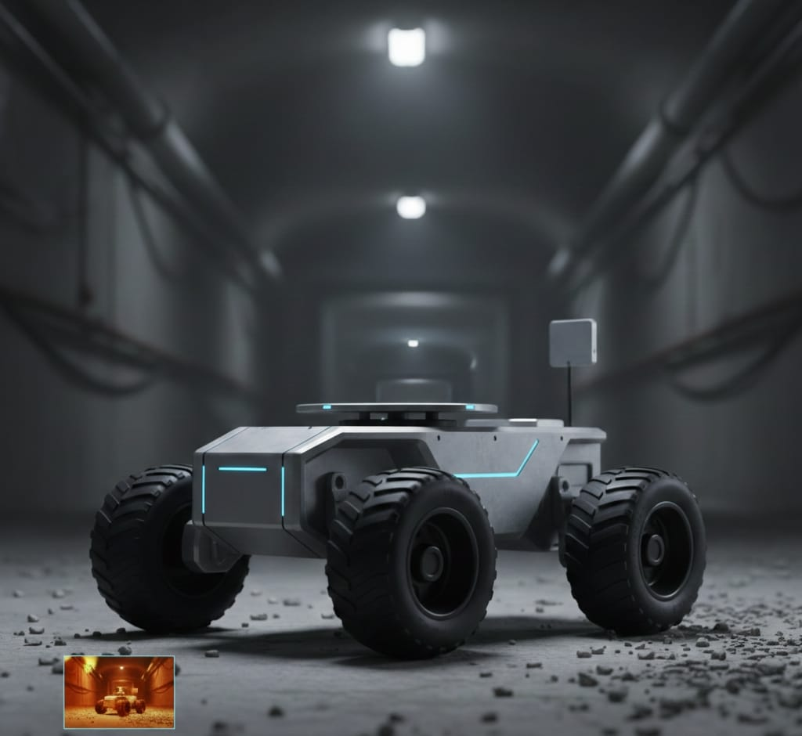




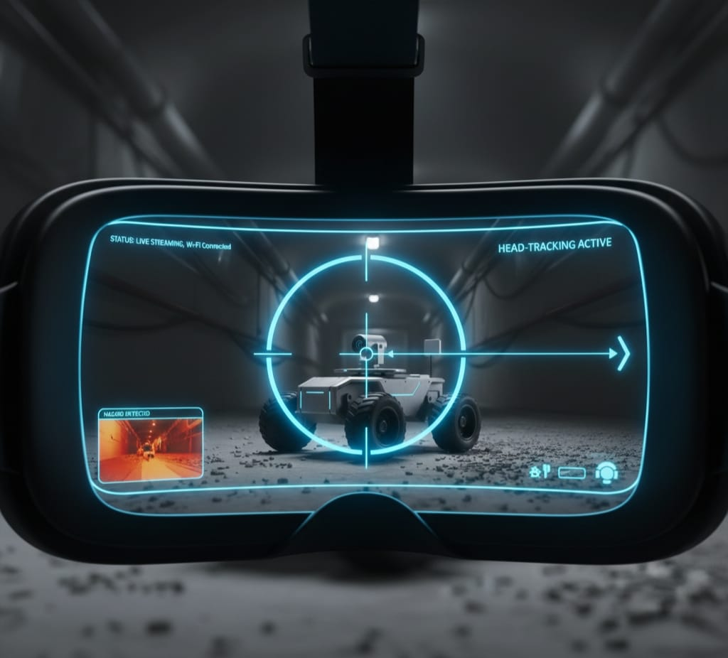

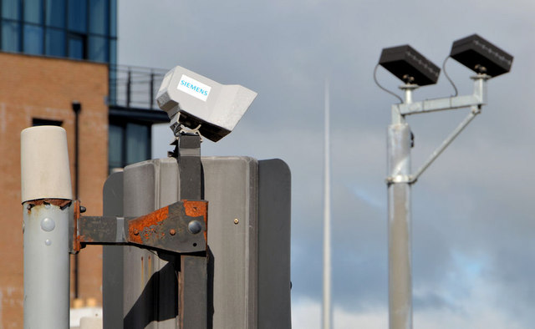

Proposed Solution
Develop a Wi-Fi controlled mobile rover for remote surveillance.
Integrate a live video streaming camera for real-time monitoring.
Implement head-tracking control for natural and easy targeting movement.
Provide manual remote operation for rover navigation.
Enable safe monitoring of hazardous or inaccessible areas.
The proposed system offers safe, efficient, and user-friendly remote surveillance and targeting.

Slide 6
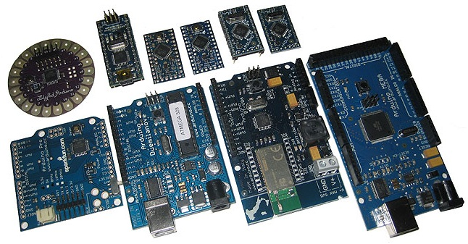




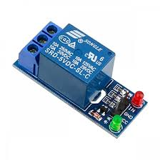
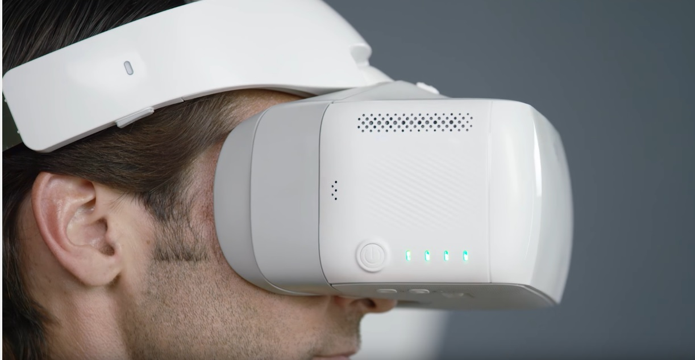



Technology used
Software Used
ARDUINO IDE
EasyEDA
Microcontroller / Controller Board
Controls rover operations.
Wi-Fi Communication
For wireless control and video transmission.
Altium 360
AutoDesk
Ltspice
Head-Tracking Technology
Controls camera/target movement based on head motion.
Analog Relay Control Circuit
Switch high-power devices or modules safely through low-power control signals.
Kicad

Slide 7
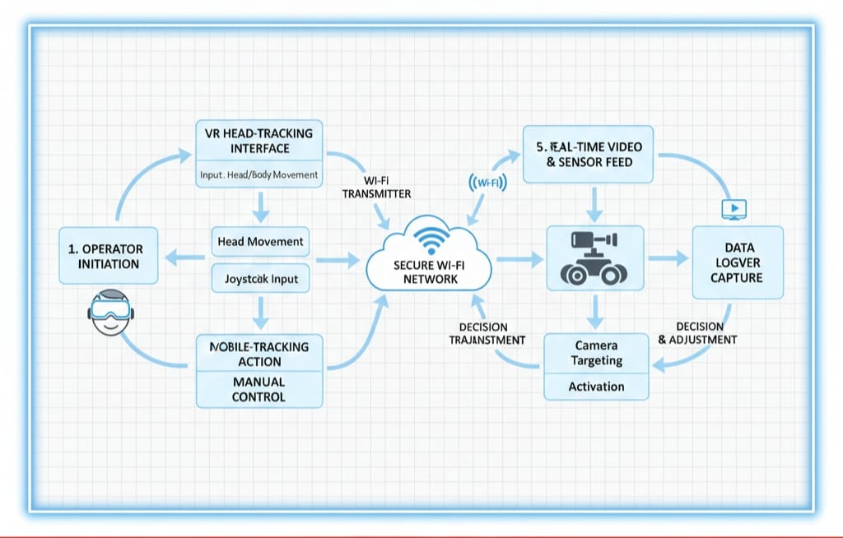
Technical flow diagram -

Slide 8
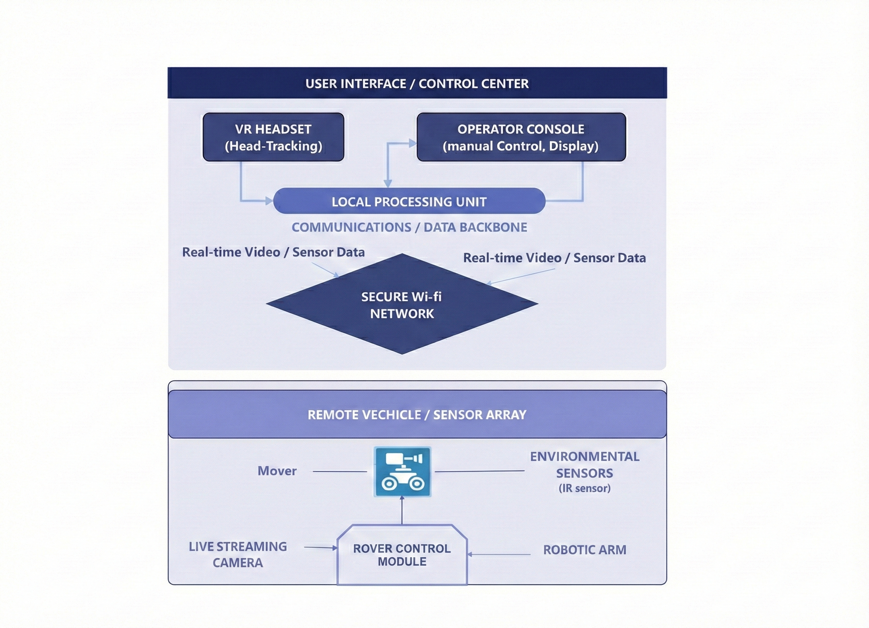
Architecture Blueprint

Slide 9
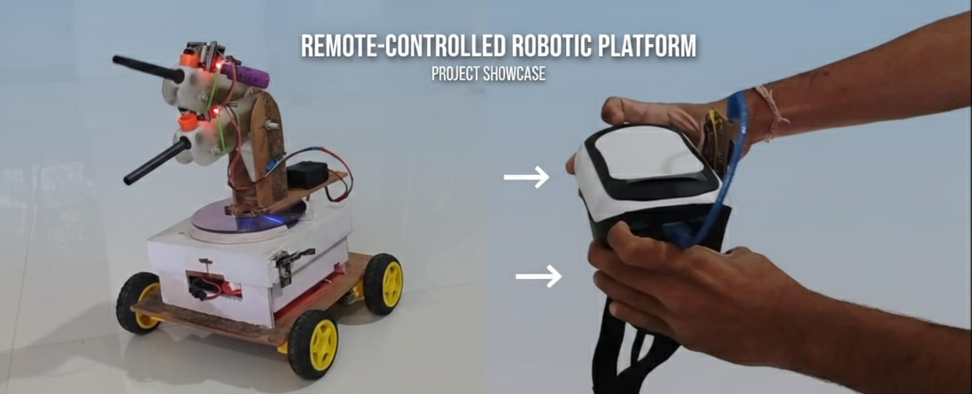
Screen shots of your project -
Down
Up
Right
Left

Slide 10
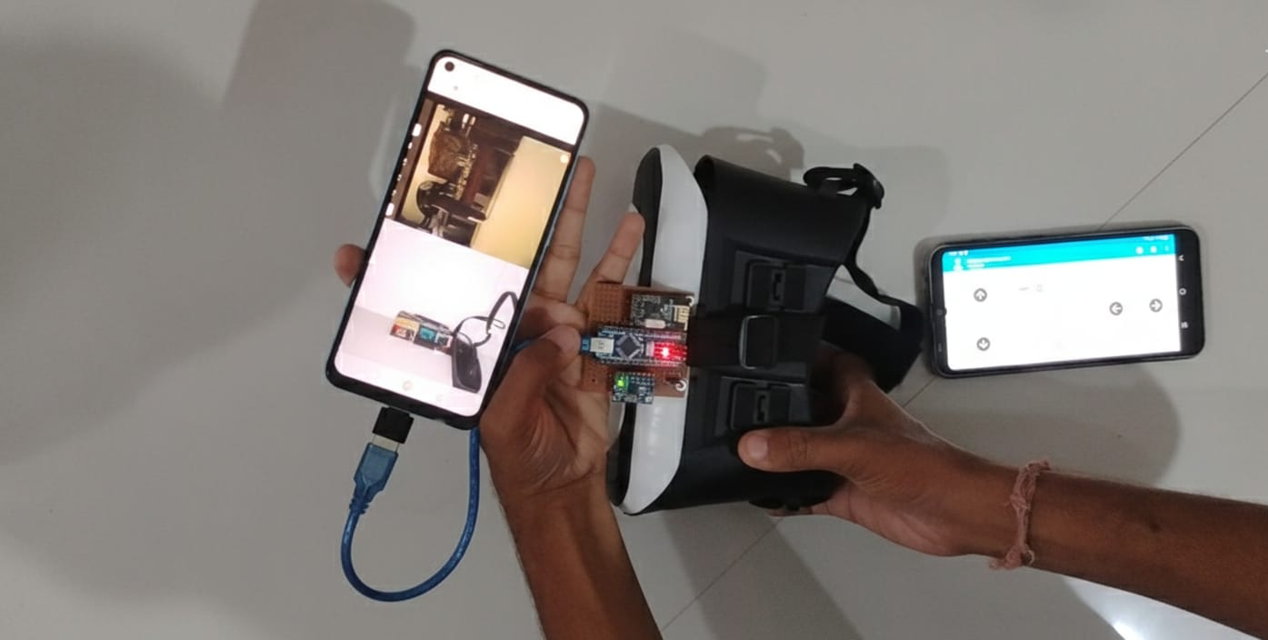
Screen shots of project -

Slide 11
Novelty and Uniqueness
1
2
3
4
Combines live video streaming and head-tracking control in a single rover system.
Provides natural camera/target control using head movement
Enables real-time mobile surveillance instead of fixed camera monitoring.
Suitable for multiple applications like defense, rescue, and industrial inspection.

Slide 12

Git Hub Link
WARVIDS

Slide 13
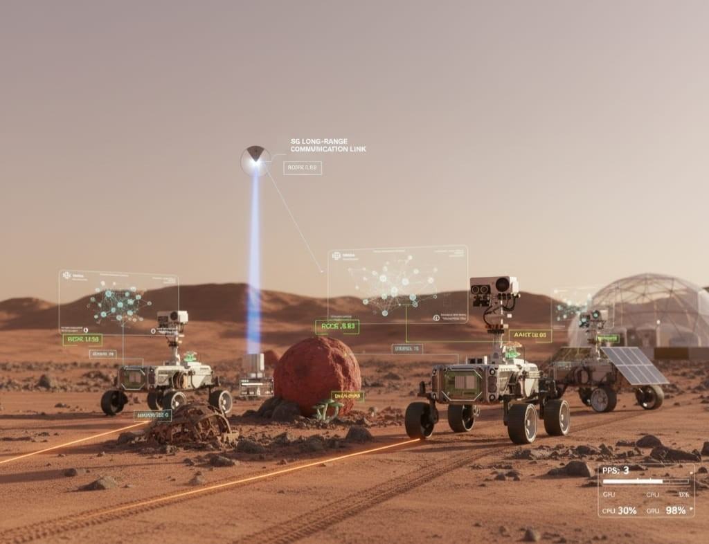
Future Scope
Add AI so the rover can detect and recognize objects on its own.
Use 5G or long-range communication for faster and longer wireless control
Connect multiple rovers to work together as a team.
Improve battery life with solar or advanced power systems.
Add smart navigation so the rover can map and explore new areas automatically.

Slide 14
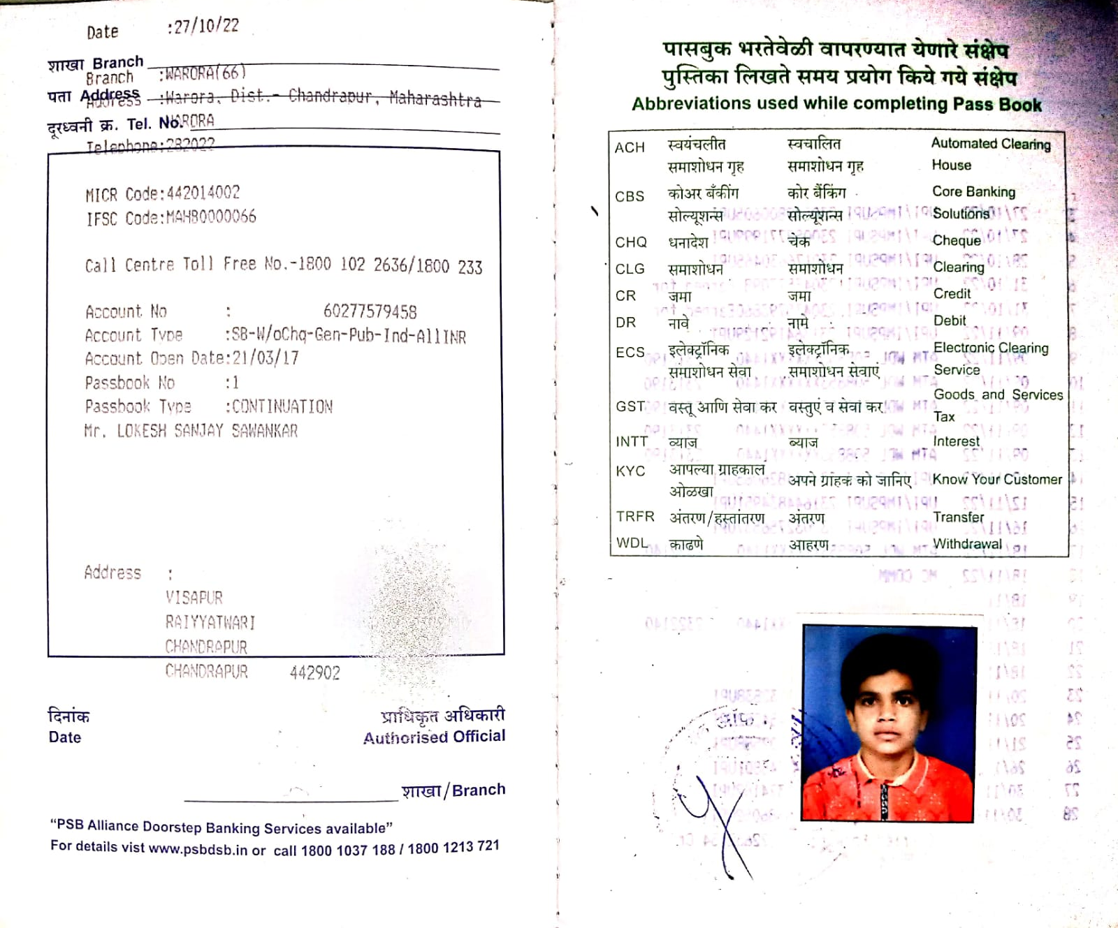
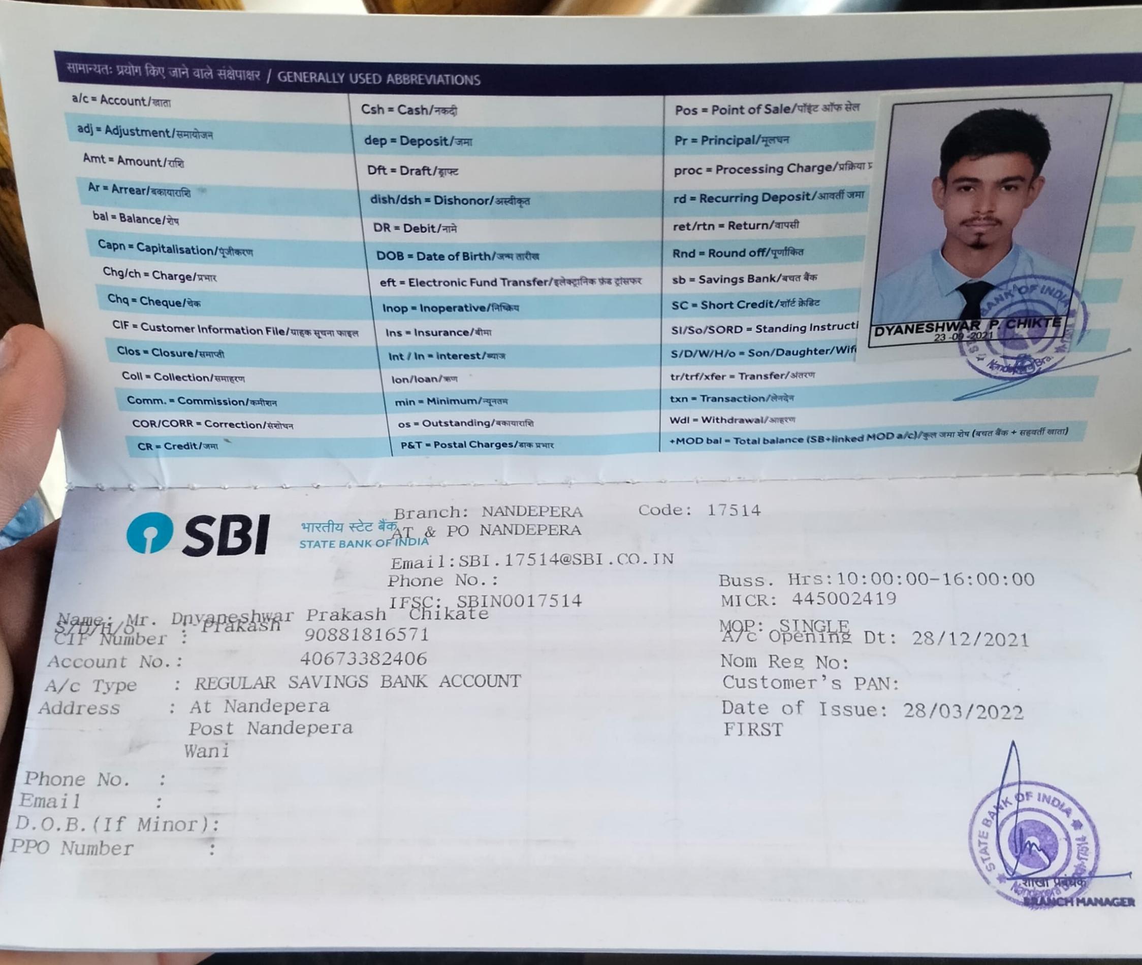
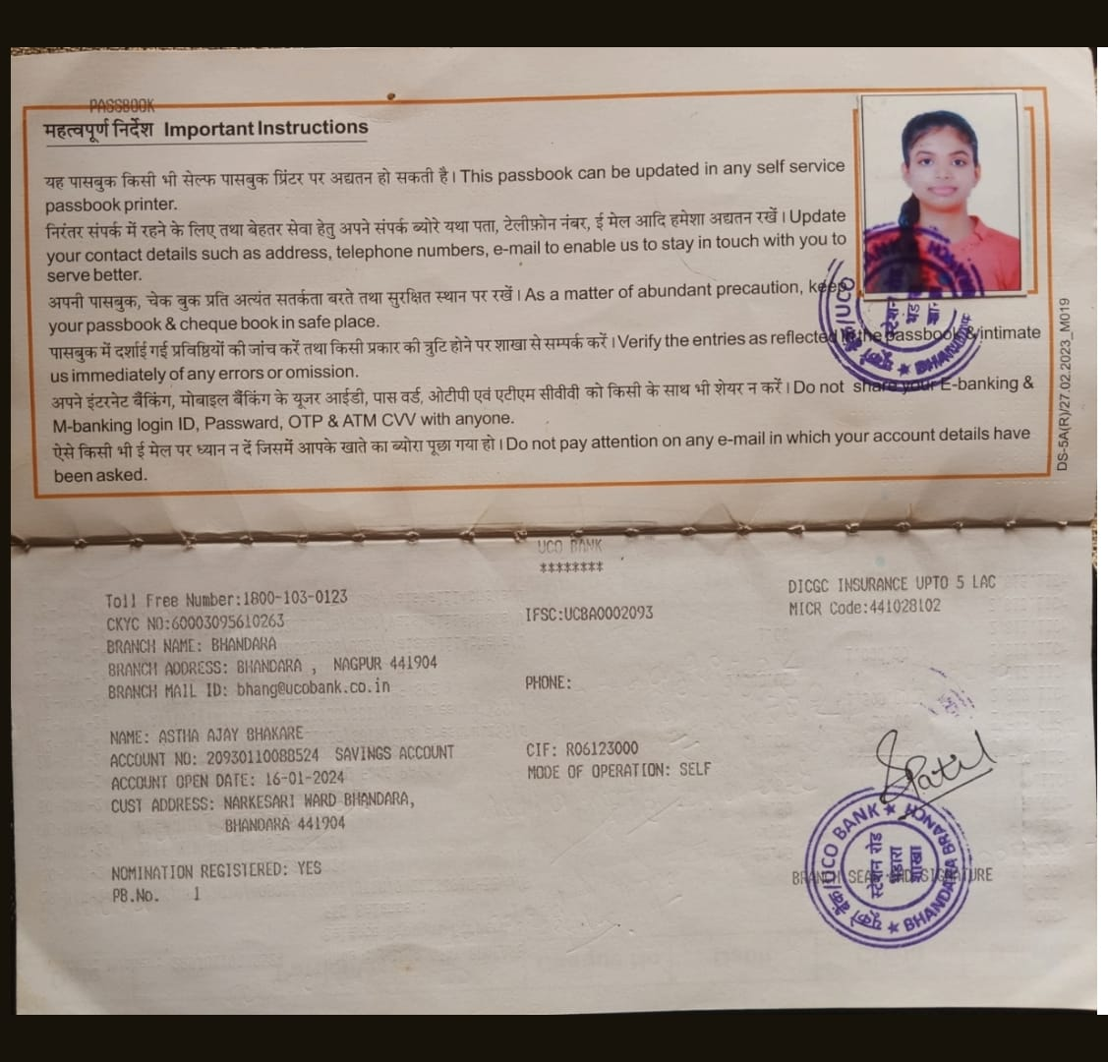
Bank Details
Full Name (as per bank records): | Bank Name | Branch Name | Account Number | Account Type (Savings / Current) | IFSC Code
LOKESH SANJAY SAWANKAR | BANK OF MAHARASHTRA | WARORA | 60277579458 | SAVINGS | MAHB0000066
DNYANESHWAR PRAKASH CHIKTE | STATE BANK OF INDIA | NANDEPERA | 40673382406 | SAVINGS | SBIN0017514
ASTHA AJAY BHAKARE | UCO BANK | BHANDARA | 20930110088524 | SAVINGS | UCBA0002093
Insert photo of passbook / bank statement
Insert photo of passbook / bank statement
Insert photo of passbook / bank statement
Team Member 1 LOKESH SANJAY SAWANKAR
60277579458
Team Member 2 DNYANESHWAR PRAKASH CHIKTE
40673382406
Team Member 3 ASTHA AJAY BHAKARE
20930110088524

Slide 15
Thank You

